Slide 1
MOSCOW PRIORITISATION

Slide 2
Definition
MoSCoW is a prioritisation technique for helping to understand and manage priorities. The letters stand for:
  Must Have
  Should Have
  Could Have
  Won’t Have this time

Slide 3
Must Have
No point in delivering on target date without this
Not legal without it
Unsafe without it
Cannot deliver a viable solution without it
Notes:
Ask the question ‘what happens if this requirement is not met?’ If the answer is ‘cancel the project – there is no point in implementing a solution that does not meet this requirement’, then it is a Must Have requirement.

Slide 4
Should Have
Important but not vital
May be painful to leave out, but the solution is still viable
May need some kinds of workaround

Slide 5
Could Have
Wanted or desirable but less important
Less impact if left out (compared with a Should Have)

Slide 6
Won’t Have this time
These are requirements which the project team has agreed will not be delivered (as part of this timeframe).
They are recorded in the Prioritised Requirements List where they help clarify the scope of the project.

Slide 7
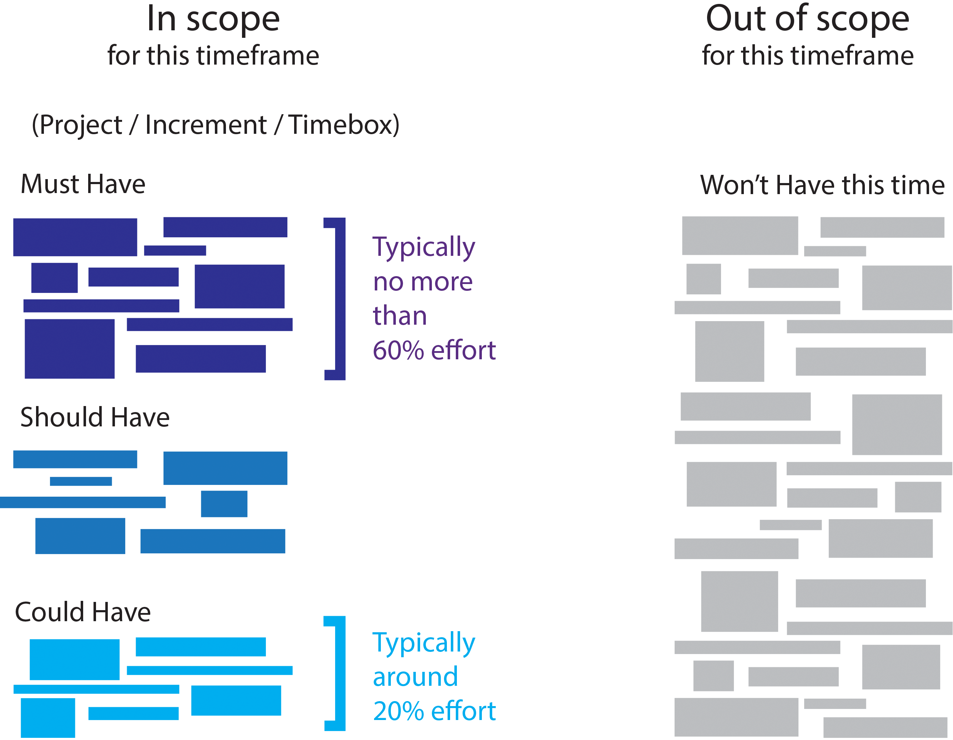
MoSCoW – balancing priorities

